Slide 1
Benchmarking for diarization:
Lessons from the DIHARD evaluation series
Neville Ryant
Linguistic Data Consortium
nryant@ldc.upenn.edu

Slide 2
What is diarization?
Short version -- who spoke when
Rather longer version
Speaker diarization is the process of partitioning a conversation into speaker homogenous speech segments.
But, perhaps it's best to just start with an example...

Slide 3

Excerpt from Fresh Air
Terry Gross: Did you get any royalties since you'd already sold the song?
Willie Nelson: Not really. {laughs} Not really.
Terry Gross: Would you- would you sing us a bit of the "Family Bible" and tell us what went into the writing of it?
Willie Nelson: Well, this is sort of autobiographical, or practically 100 percent
autobiographical.

Slide 4
Why does diarization matter?
preprocessing step for automatic speech recognition
identify overlap regions for special handling
enable speaker adaptive acoustic modeling (e.g., see work from 1990s)
make ASR output more useful for humans and downstream tasks (e.g., summarization, parsing, machine translation)
motivation behind NIST Rich Transcription evaluations
to enable automatic extraction of purely phonetic parameters such as distribution of pitch or speech/non-speech durations

Slide 5
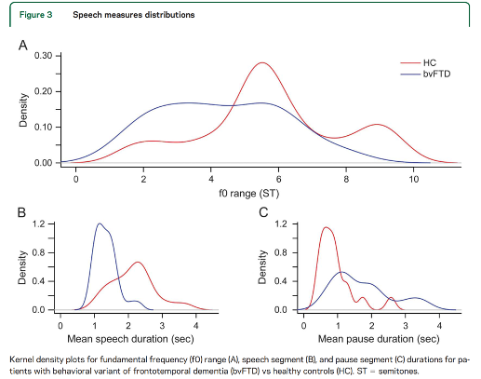
Why does diarization matter?
Nevler et al. (2017). "Automatic measurement of prosody in behavioral variant FTD."

Slide 6
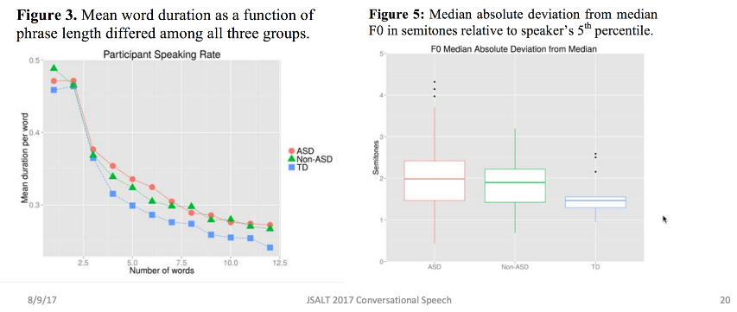
Why does diarization matter?
Parish-Morris et al. (2016). "Exploring autism spectrum disorders using HLT."

Slide 7
A brief history of diarization research

Slide 8
Pre-2000
early systems focused on isolating air traffic controllers from pilots in NIST Air Traffic Controller corpus; e.g.,
Gish, H., Siu, M.H., and Rohlicek, R. (1991). “Segregation of speakers for speech recognition and speaker identification”
Siu, Man-Hung, Yu, G., and Gish, H. (1992). “An unsupervised, sequential learning algorithm for the segmentation of speech waveforms with multiple speakers.”
or segmenting speakers in broadcast news (HUB-4) for purposes of speaker-adaptive modeling
Chen, S.S. and Gopalakrishnan, P.S. (1998). “Speaker, environment, and channel change detection and clustering via the Bayesian Information Criterion.”

Slide 9
Pre-2000
typical system had three stages:
speech activity detection (SAD)
energy-based thresholding
changepoint detection
split speech segments when speaker changes
distance metric based on Bayesian information criterion (BIC)
clustering
agglomerative hierarchical clustering (AHC)
Generalized Likelihood Ratio (GLR) distance metric

Slide 10
2002-2009 -- NIST Rich Transcription (RT) Series
2002-2009 -- NIST ran an evaluation series focused on enriching speech-to-text output with additional metadata to make them more useful by humans and downstream tasks
8 of these evaluations included a speaker diarization component
early evaluations focused on CTS and broadcast news, but focus shifted to meeting speech in later years
introduced diarization error rate (DER), which remains the principal evaluation metric in the field

Slide 11
2002-2009 -- NIST Rich Transcription (RT) Series
RT series fostered flurry of work, leading to substantial improvements in diarization, especially for the meeting domain
many advancements:
beamforming for microphone arrays
transition to supervised SAD systems (e.g., GMM-HMM) to handle the more complex acoustic environments in meeting speech
automated determination of stopping criterion during AHC
segment representation by latent factors (joint factor analysis (JFA))
Variational Bayes (VB) clustering
Viterbi resegmentation of clustering output

Slide 12
2009-2017 -- Wilderness Years
2009-2017: work on diarization continued in many groups
≈48 papers/year included some variant of the term "diarization" in their title
≈409 papers/year mentioned diarization somewhere in their body
→ many clear advances, often in tandem with speaker recognition:
i-vectors/x-vectors for segment representation
PLDA scoring
improved clustering

Slide 13
2009-2017 -- Wilderness Years
however, NO major evaluations with a diarization component
→ fragmentation of the community
different groups focus on different domains/data (e.g., broadcast news, CTS, meeting speech)
sometimes inconsistent evaluation procedures
→ difficult to compare systems and gauge progress

Slide 14
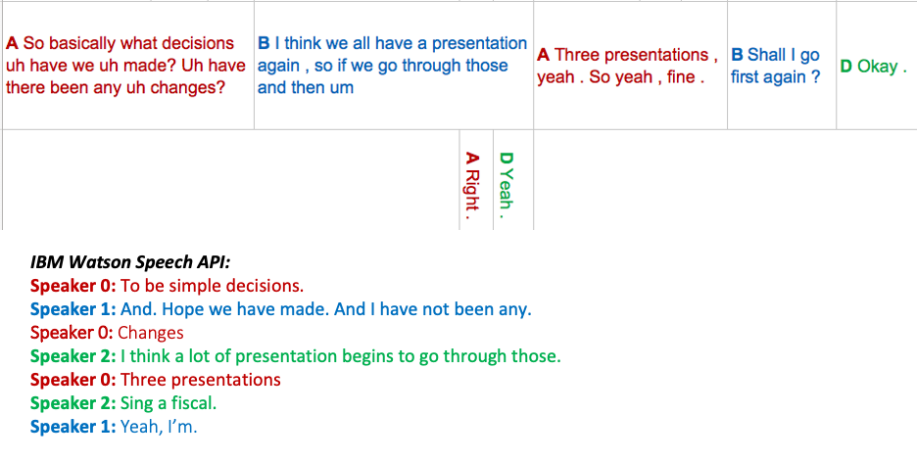
IBM Watson in 2017

Slide 15
DIHARD

Slide 16
Overview
DIHARD is a new series of speaker diarization evaluations intended to address the fragmentation of the research community that was apparent in 2017
focus is on robust diarization; that is, diarization that is resilient to variation in:
conversational domain
recording equipment
recording environment
reverberation
ambient noise
number of speakers
speaker demographics
etc.

Slide 17
History of DIHARD
DIHARD I (2018)
13 teams
https://dihardchallenge.github.io/dihard1/
DIHARD II (2019)
21 teams
https://dihardchallenge.github.io/dihard2/
DIHARD III (2020)
21 teams
evaluation: https://dihardchallenge.github.io/dihard3/
workshop: https://dihardchallenge.github.io/dihard3workshop/

Slide 18
DIHARD Task
for each recording:
determine how many speakers are present
for each speaker, identify all corresponding speech segments
two tracks
Track 1 -- Diarization from reference SAD
Systems are provided with a reference speech segmentation that is generated by merging speaker turns in the reference diarization
Track 2 -- Diarization from scratch
Systems are provided with just the raw audio input for each recording session and are responsible for producing their own speech segmentation

Slide 19

Diarization Error Rate (DER)
introduced for RT-03S evaluation
total percentage of reference speaker time that is not correctly attributed to a speaker, where "correctly attributed" is defined in terms of an optimal mapping:
where:
TOTAL is the total reference speaker time; that is, the sum of durations of all reference speaker segments
FA is the total system speaker time not attributed to a reference speaker
MISS is the total reference speaker time not attributed to a system speaker
ERROR is the total reference speaker time attributed to the wrong speaker

Slide 20
Datasets
Training data
no training data is distributed
participants are free to use any public/proprietary data
in practice, most teams use some combination of VoxCeleb and CommonVoice
Development/evaluation data
5-10 minute duration recordings from 13 conversational domains
at least 2 hours of audio per domain
majority of data segmented manually (and painfully)
remainder segmented by forced-alignment of turn-level transcriptions

Slide 21
DIHARD Domains
audiobooks
broadcast interview
child language acquisition
clinical
conversational telephone speech
courtroom
dinner party
map task
meetings
restaurant conversation
sociolinguistic field recordings
sociolinguistic lab recordings
web video

Slide 22
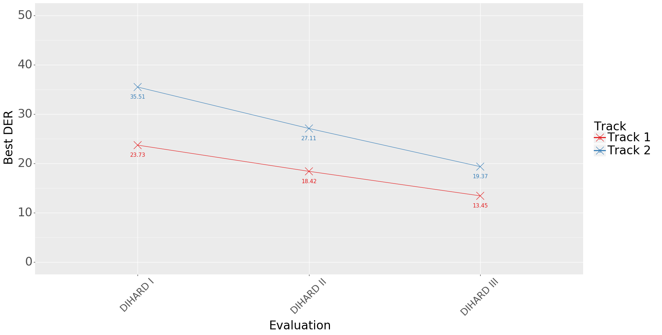
DER has decreased over time

Slide 23
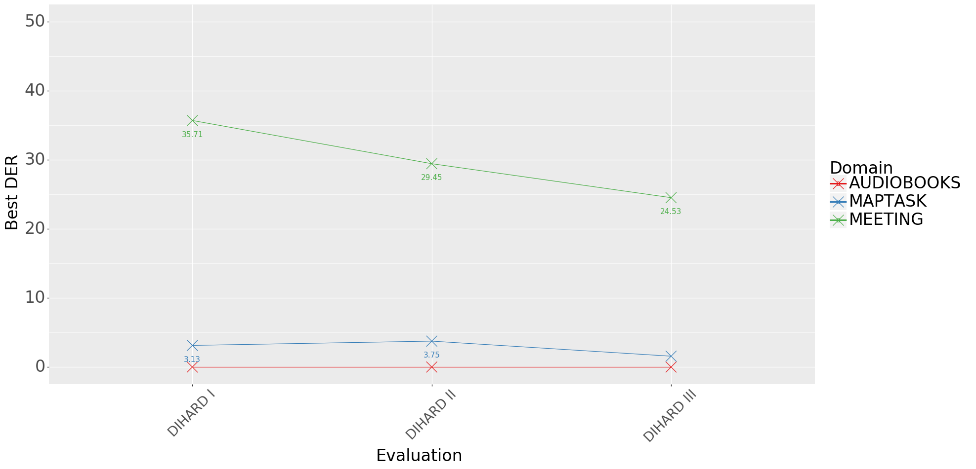
Track 1: Improvement by domain

Slide 24
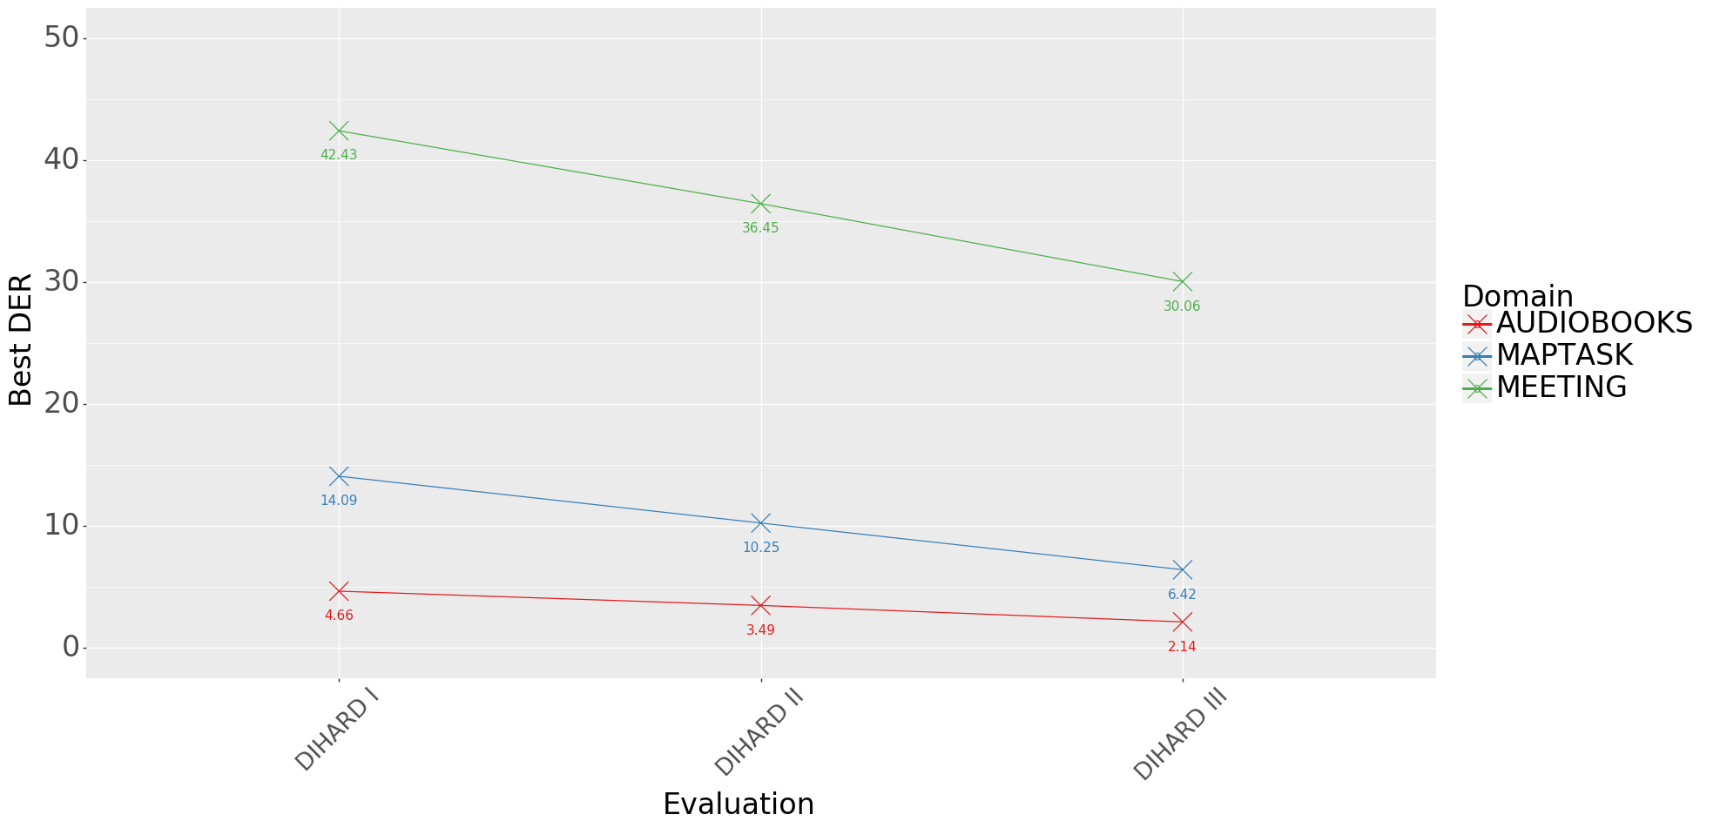
Track 2: Improvement by domain

Slide 25
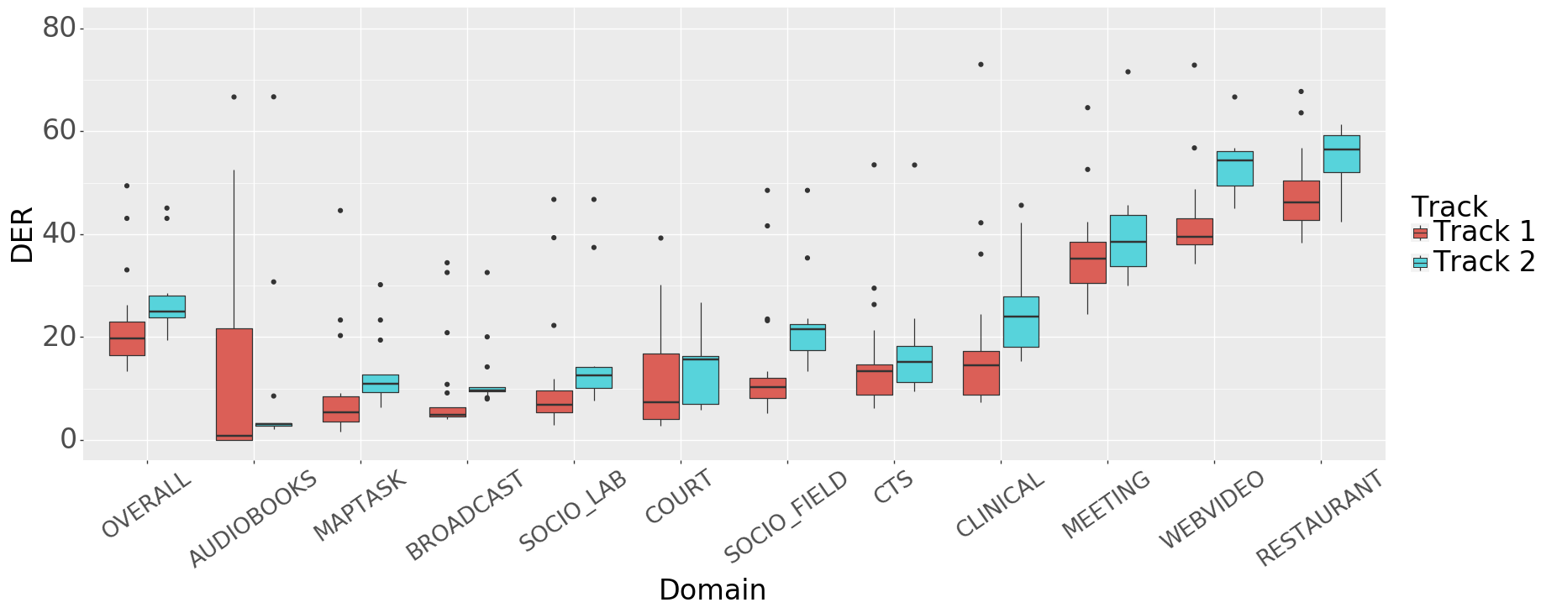
DIHARD III: DER by domain

Slide 26
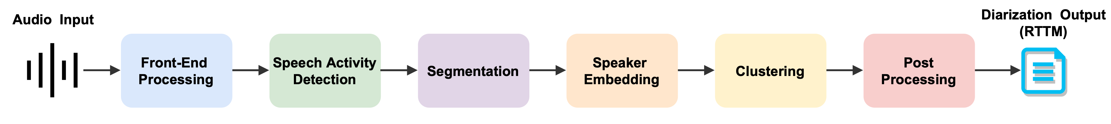
Modular diarization architecture
Park, T.J., et al. (preprint). "A review of speaker diarization: Recent advances with deep learning."
Front end processing
beamforming
dereverberation
speech enhancement
Speech activity detection
LLRT using GMMs
DNNs
Speaker Embedding
i-vectors
x-vectors/d-vectors/etc
Clustering
agglomerative hierarchical clustering (AHC)
spectral clustering
VB-HMM
PLDA scoring
DNN based scoring
Post-processing
resegmentation
Viterbi
VB-HMM
system fusion
DOVER
DOVERLAP
TS-VAD

Slide 27
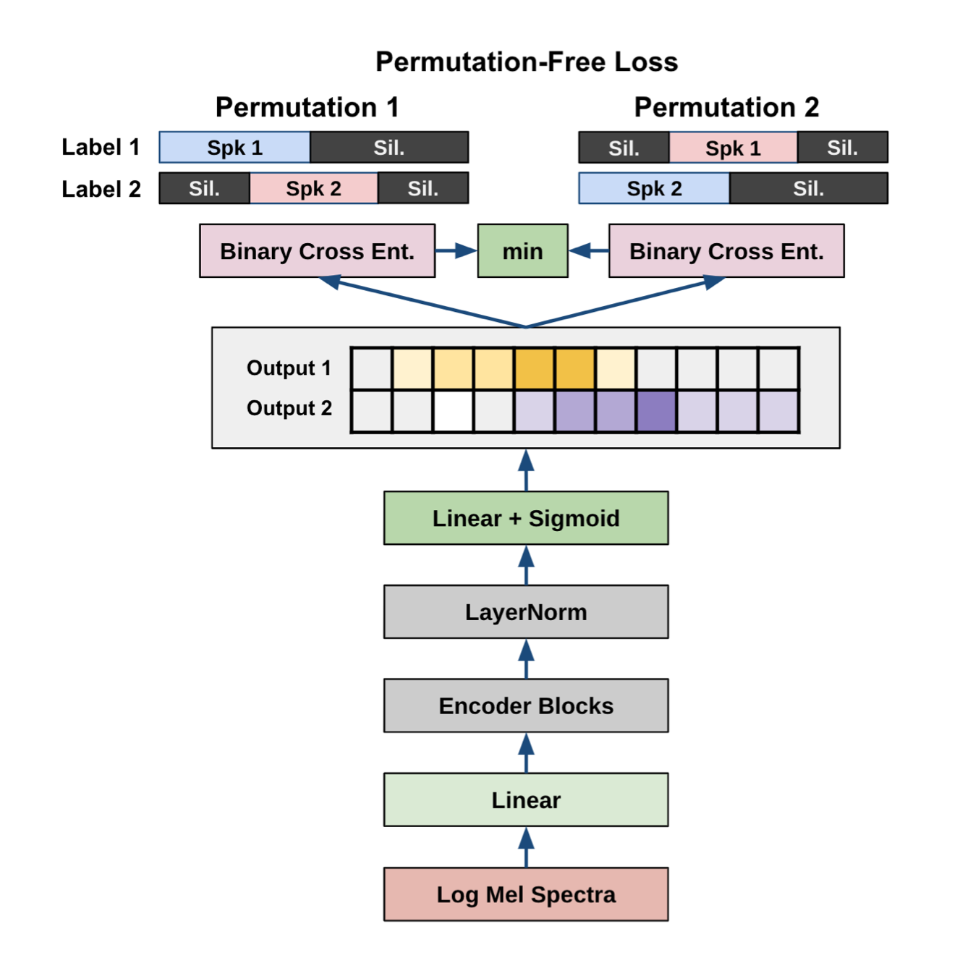
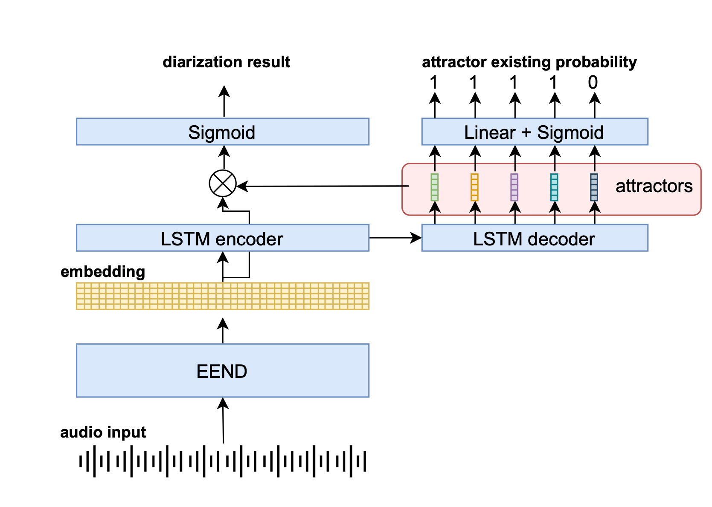
End-to-end diarization
EEND (Fujita et al., 2019)
EDA-EDA (Horiguchi et al., 2020)
Fujita et al., (2019). "End-to-end speaker diarization with permutaion-free objectives."
Horighuchi et al. (2020). "End-to-end speaker diarization for an unknown number of speakers with encoder-decoder based attractors."
Park, T.J., et al. (preprint). "A review of speaker diarization: Recent advances with deep learning."

Slide 28
Looking forward

Slide 29
Lessons learned
diarization is still hard
when reference SAD is withheld, DER for many domains remains exceeds 20%
for web video and restaurant speech, DER exceeds 50%
even for well-studied domains such as meeting speech, DER still exceeds 35%
commercial APIs also still regularly fail spectacularly

Slide 30
IBM Watson in 2017

Slide 31
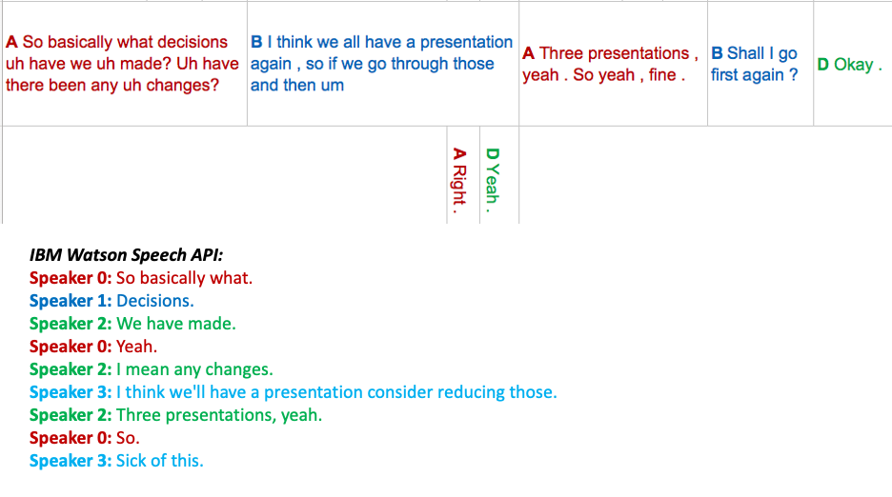
IBM Watson in 2021

Slide 32
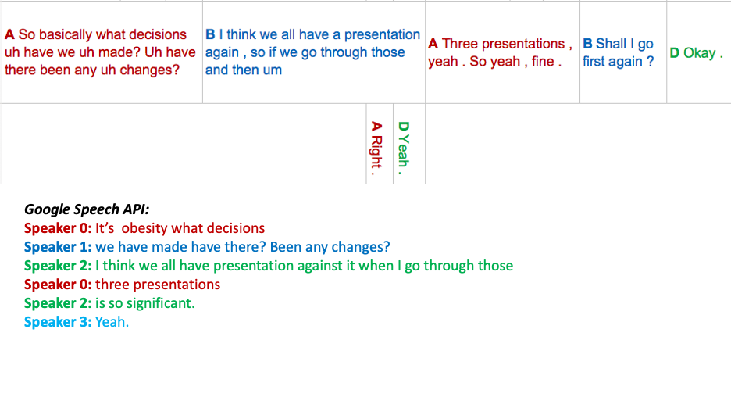
Google in 2021

Slide 33
Lessons learned
manual annotation at scale is not feasible
domains that are hard for systems are also hard for humans; even with PhD knowledge of acoustic phonetics and ASR
for SEEDLingS, real-time rates sometimes exceeded 31X
much of this difficulty is driven by overlapped speech, which is hard for humans as well as machines
annotation at scale requires "cheating"
forced alignment using clean audio
use multiple modalities

Slide 34
Lessons learned
diarization error rate may not be the right metric
like word error rate (WER) it is simple, easy to compute, and generally applicable across domains
readily lends itself to ranking and charting progress over time
BUT, doesn't gracefully handle scoring of overlapped speech
more importantly, it's not clear that improvements in DER correlate with improvements in real world diarization performance
should probably move to measuring impact of diarization for downstream tasks such as speech-to-text
e.g., as CHiME-6 did

Slide 35
Lessons learned
interest (and money?) for continued work in this area is out there!
DIHARD submissions over time:
DIHARD I: 13
DIHARD III: 21 teams (comprising 30 sites)
diarization is now included in multiple other challenges:
ChiME-6 -- dinner parties (Track 2)
https://chimechallenge.github.io/chime6/
Fearless Steps I & II -- massively multichannel data from Apollo 11 mission
https://fearless-steps.github.io/ChallengePhase2/index.html
VoxSRC-20 -- multi-speaker YouTube videos
https://www.robots.ox.ac.uk/~vgg/data/voxceleb/competition2020.html
Iberspeech -- diarization of television broadcasts and longitudinal diarization
http://catedrartve.unizar.es/albayzin2020.html

Slide 36
Future plans
no DIHARD IV in 2021
using 2021 to deal with accumulated technical debt and produce retrospective analysis
DIHARD will return in 2022 with a new dataset and task specification negotiated jointly with the community
for updates, sign up to the mailing list:
dihardchallenge@ldc.upenn.edu

